Slide 1
Research Approaches
There are two basic approaches to research, viz., quantitative approach and the qualitative approach.
Quantitative approach is further classified into
1. Inferential- database to Infer characteristics/ relationships of population.
2. Experimental- some variables are manipulated to observe their effect on other variables
3. Simulation approach - involves the construction of an artificial environment within which relevant information and data can be generated.

Slide 2
Research Approaches
Qualitative approach research is concerned with subjective assessment of attitudes, opinions and behavior.
Research in such a situation is a function of researcher’s insights and impression
Generally, the techniques of focus group interviews, projective techniques and depth interviews are used.

Slide 3
Significance of Research
To aid economic policy.
Important for social scientists to answer the social problem.
To form government policies.
In the context of government, research as a tool to economic policy has three distinct phases of operation, viz.,
Investigation of economic structure through continual compilation of facts
Diagnosis of events that are taking place and the analysis of the forces underlying them
The prognosis, i.e., The prediction of future developments.

Slide 4
Significance in solving various operational and planning problems of business and industry.
Operations research and market research, along with motivational research, are considered crucial in taking business decisions.
Market research is the investigation of the structure and development of a market for the purpose of formulating efficient policies for purchasing, production and sales.
Operations research refers to the application of mathematical, logical and analytical techniques to the solution of business problem.
Motivational research of determining why people behave as they do is mainly concerned with market characteristics.

Slide 5
In addition to what has been stated above, the significance of research can also be understood keeping in view the following points:
(a) To those students who are to write a master’s or Ph.D. thesis, research may mean a careerism or a way to attain a high position in the social structure;
(b) To professionals in research methodology, research may mean a source of livelihood;
(c) To philosophers and thinkers, research may mean the outlet for new ideas and insights;
(d) To literary men and women, research may mean the development of new styles and creative work;
(e) To analysts and intellectuals, research may mean the generalizations of new theories.

Slide 6
Research Methods versus Methodology
Research methods may be understood as all those methods/techniques that are used for conduction of research.
All those methods which are used by the researcher during the course of studying his research problem are termed as research methods.
Research methods can be put into the following three groups:
1. In the first group we include those methods which are concerned with the collection of data. These methods will be used where the data already available are not sufficient to arrive at the required solution;
2. The second group consists of those statistical techniques which are used for establishing relationships between the data and the unknowns;
3. The third group consists of those methods which are used to evaluate the accuracy of the results obtained.

Slide 7
Research methodology
It is a way to systematically solve the research problem. It may be understood as a science of studying how research is done scientifically
In it we study the various steps that are generally adopted by a researcher in studying his research problem along with the logic behind them-
For example, an architect, who designs a building, has to consciously evaluate the basis of his decisions, i.e., he has to evaluate why and on what basis he selects particular size, number and location of doors, windows and ventilators, uses particular materials and not others and the like.

Slide 8
The scope of research methodology is wider than that of research methods.
When we talk of research methodology we not only talk of the research methods but also consider the logic behind the methods we use in the context of our research study and explain why we are using a particular method or technique and why we are not using others so that research results are capable of being evaluated either by the researcher himself or by others.

Slide 9
Research and Scientific Method
Scientific method is the pursuit of truth as determined by logical considerations.
The ideal of science is to achieve a systematic interrelation of facts.
Scientific method attempts to achieve “this ideal by experimentation, observation, logical arguments from accepted postulates and a combination of these three in varying proportions.”
In scientific method, logic aids in formulating propositions explicitly and accurately so that their possible alternatives become clear.

Slide 10
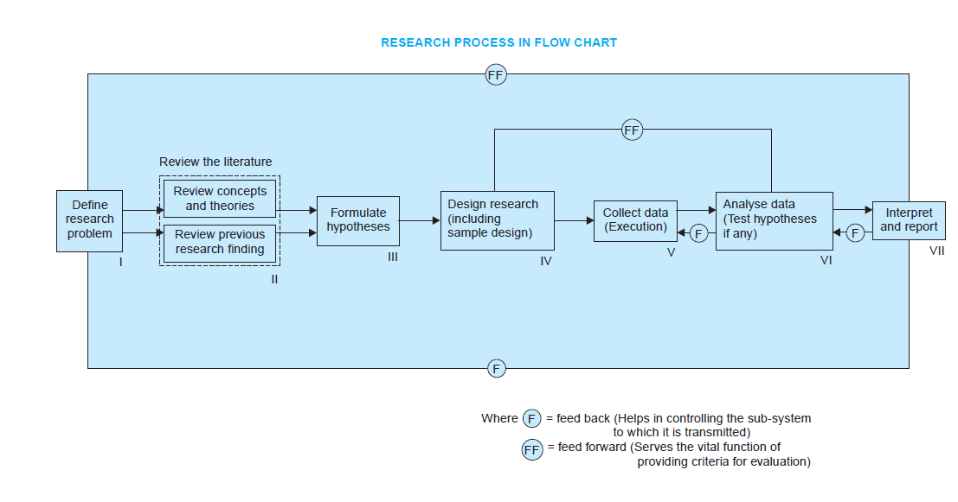


Research Process

Slide 11
Research Process
Formulating Research Problem
There are two types of research problems.
Those which relate to states of nature
Those which relate to relationships between variables
Two steps are involved in formulating the research problem
Understanding the problem thoroughly
Rephrasing the same into meaningful terms from an analytical point of view.

Slide 12
Research Process
2. Literature Survey
The researcher should undertake extensive literature survey connected with the problem.
For this purpose, the abstracting and indexing journals and published or unpublished bibliographies are the first place to go to.
Academic journals, conference proceedings, government reports, books etc., must be tapped depending on the nature of the problem. In this process, it should be remembered that one source will lead to another

Slide 13
Research Process
3. Development of working hypotheses
Working hypothesis- Tentative assumption made in order to draw out and test its logical or empirical consequences.
Hypothesis should be very specific and limited to the piece of research in hand because it has to be tested.
Hypothesis - Role - Guide the researcher by delimiting the area of research and to keep him on the right track. It sharpens his thinking and focuses attention on the more important facets of the problem. It also indicates the type of data required and the type of methods of data analysis to be used.

Slide 14

Research Process
4. Preparing the Research Design
It is a conceptual structure within which research would be conducted.
Function of research design is to provide for the collection of relevant evidence with minimal expenditure of effort, time and money.
Research purposes may be grouped into four categories, viz., (i) Exploration, (ii) Description,
(iii) Diagnosis, and (iv) Experimentation.
There are several research designs, such as, experimental and non-experimental hypothesis testing.
Research Designs depends on:
Means of obtaining information
skills of the researcher
time available
cost factor (finance available)

Slide 15
Research Process
5. Determining Sample Design:
Sample:
We select only a few items in the universe for our study purpose.
Ex- Blood Sample.
No element of chance is left and highest accuracy is obtained.
Sample Design:
It is a definite plan determined before any data are
actually collected for obtaining a sample from a given population.
Samples can be either probability samples or non-probability samples.

Slide 16
Probability samples
simple random sampling
systematic sampling
stratified sampling
cluster/area sampling
Non-probability samples
convenience sampling
judgement sampling
quota sampling techniques.

Slide 17


Research Process
6. Collecting the Data
By observation
Through personal interview
Through telephone interview
By mailing of questionnaires
Through schedules

Slide 18
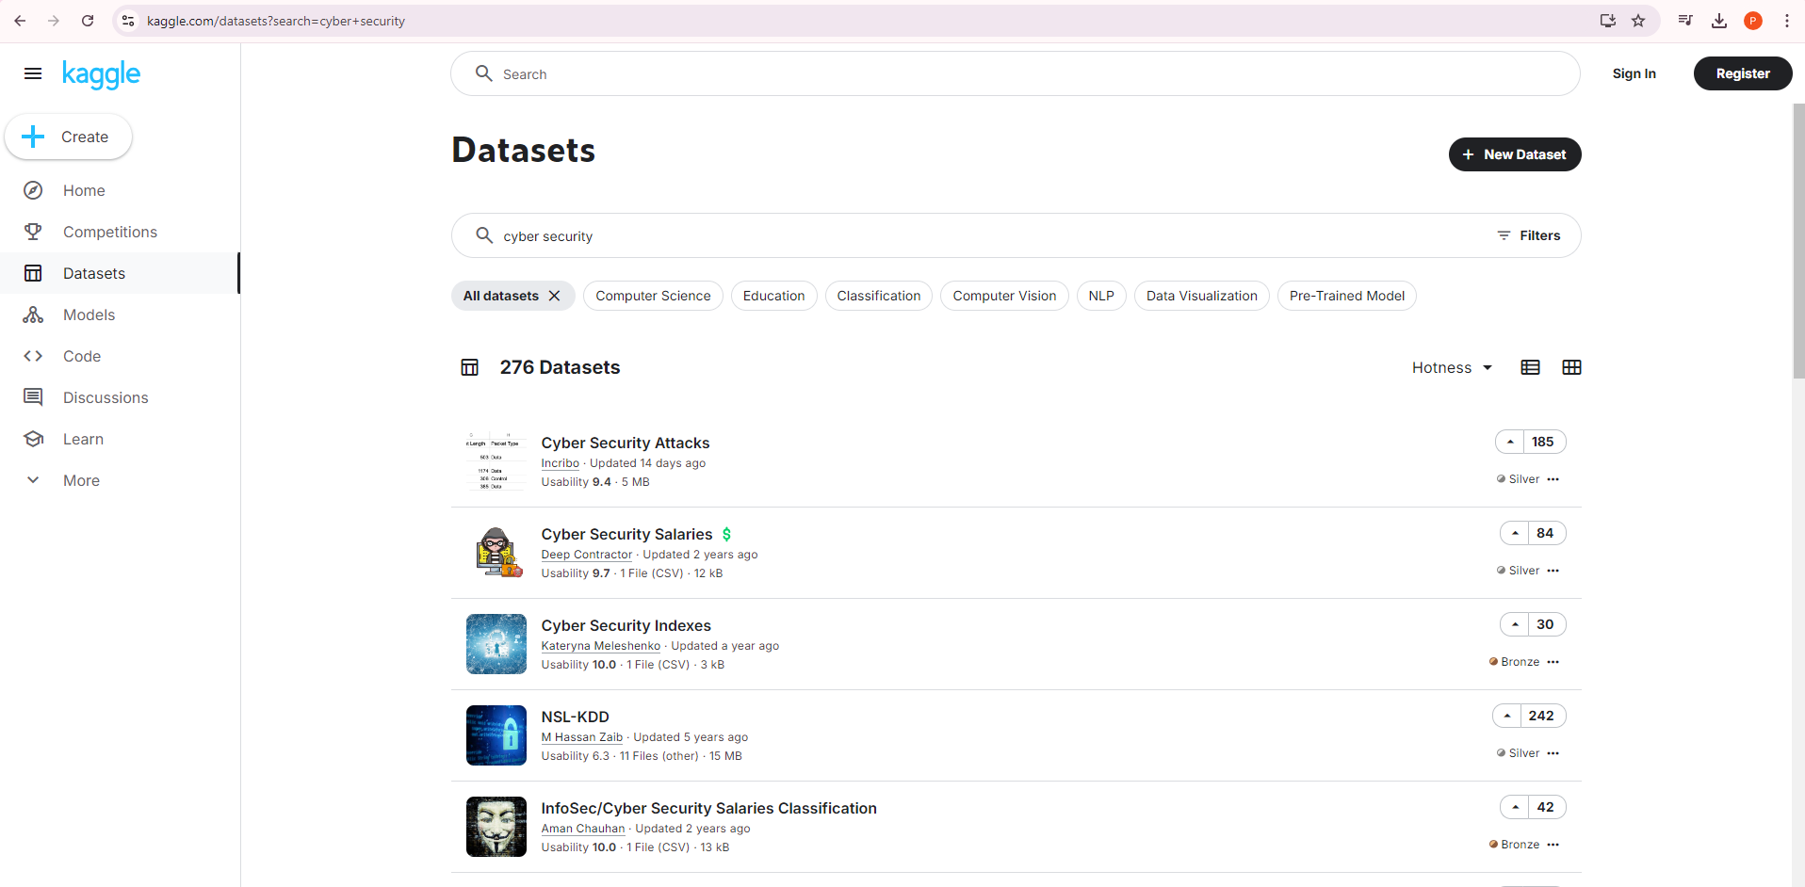
Kaggle

Slide 19


Slide 20
Research Process
7. Execution of the project
Project is executed in a systematic manner and in time.
If the survey is to be conducted by means of structured questionnaires, data can be readily machine-processed.
If the data are to be collected through interviewers, arrangements should be made for proper selection and training of the interviewers.

Slide 21
Research Process
8. Analysis of data
It requires a number of operations such as establishment of categories, the application of these categories to raw data through coding, tabulation and then drawing statistical inferences.
Raw data to be condensed into few groups and tables for further analysis.
Coding operation- Data can be transformed into symbols that may be tabulated or counted.
Editing- Improves the quality of data for coding.
Tabulation- classified data are put in the form of tables.

Slide 22
Research Process
9. Hypothesis-testing
After analysing the data, the researcher is in a position to test the hypotheses.
Do the facts support the hypotheses or they happen to be contrary?
Various tests, such as Chi square test, t-test, F-test, have been developed to test hypothesis.
Hypothesis-testing will result in either accepting the hypothesis or in rejecting it.

Slide 23
Research Process
10. Generalisations and interpretation
If a hypothesis is tested and upheld several times, it may be possible for the researcher to arrive at generalisation, i.e., to build a theory.
If the researcher had no hypothesis to start with, he might seek to explain his findings on the basis of some theory. It is known as interpretation.

Slide 24
Research Process
11. Preparation of the report or the thesis
The layout of the report should be as follows:
(i) Preliminary pages-
Title and Date
Acknowledgements
Foreword
Table of contents
List of tables
List of graphs and charts

Slide 25
Research Process
(ii) Main text-
(a) Introduction:objective of the research, explanation of the methodology, scope
of the study along with limitations
(b) Summary of findings: statement of findings and recommendations in non-technical language
(c) Main report: logical sequence and broken-down into identifiable sections.
(d) Conclusion: Final summing up.
(iii) End matter-
Appendices
Bibliography

Slide 26
Criteria of Good Research
1. Good research is systematic
2. Good research is logical
3. Good research is empirical
4. Good research is replicable

Slide 27
Defining the Research Problem
WHAT IS A RESEARCH PROBLEM?
It refers to some difficulty which a researcher experiences in the context of either a theoretical or practical situation and wants to obtain a solution for the same.
The components of a research problem:
There must be an Individual or a group which has some difficulty or the problem.
There must be an Objective(s) to be attained at.
There must be alternative means (or the courses of action) for obtaining the objective(s).
There must remain some doubt in the mind of a researcher with regard to the selection of alternatives.
There must be some environment(s) to which the difficulty pertains.

Slide 28


Selecting the problem
Points to be observed by a researcher in selecting a research problem:
Subject which is overdone should not be normally chosen.
Controversial subject should not become the choice of an average researcher.
Too narrow or too vague problems should be avoided.
Subject selected for research should be familiar and feasible.
Costs involved and Time factor to be considered
Necessity of defining the Problem
To discriminate relevant data from irrelevant ones.
Researcher will be on track.

Slide 29




Technique involved in defining a problem
The technique for the purpose involves the undertaking of the following steps generally one after the other:
Statement of the problem in a general way: In social research, it is considered advisable to do some field observation called pilot survey.
Understanding the nature of the problem: Understand its origin and nature clearly.
Surveying the available literature: Researcher must be well conversant with relevant theories in the field, reports and records as also all other relevant literature.
Developing the ideas through discussions: Researcher must discuss his problem with colleagues in same area which is called experience survey.
Rephrasing the research problem: Researcher puts the research problem in specific terms as possible so that it may become operationally viable and may help in development of working hypothesis.

Slide 30
Following points must also be observed while defining a research problem:
Technical terms or words or phrases with special meaning used in the statement should be clearly defined.
Basic assumptions relating to research problem should be clearly stated.
A straight forward statement of the value of the investigation should be provided.
The suitability of the time- period and the sources of the data available must also be considered by the researcher in defining the problem.
The scope of the investigation must be mentioned explicitly in defining a research problem.

Slide 31




Research Design
Chapter 3
A research design is the arrangement of conditions for collection and analysis of data in a manner that aims to combine relevance to the research purpose with economy in procedure.
Overall research design may be split into the following parts:
Sampling Design: Method of selecting the items
Observational Design: Conditions under which the observations are to be made.
Statistical Design: How many items are to be observed and how the information and data gathered is to be analysed.
Operational Design: Deals with techniques by which the procedures specified in sampling, statistical and observational designs can be carried out.

Slide 32
Important Features of Research Design
It is a plan that specifies the sources and types of information relevant to the research problem.
It is a strategy specifying which approach will be used for gathering and analysing the data.
It also includes the time and cost budgets since most studies are done under these two constraints.
Need for Research Design
Research design stands for advance planning of the methods to be adopted for collecting the relevant data and the techniques to be used in their analysis.

Slide 33



Features of a Good Design
Research Design involves the following consideration:
The means of obtaining information
The availability and skills of the researcher and his staff
The objective of the problem to be studied
The nature of the problem to be studied
The availability of time and money for the research work

Slide 34




Important concepts relating to research design
Dependent and Independent Variables:
Variable: A concept which can take on different quantitative values
Ex: Height, Weight, Income.
Continuous Variable: Phenomena which can take on quantitatively different values even in decimal points.
Discrete Variable: Expressed in integral values
Ex: Number of children.
Dependent Variable: If one variable depends on other variable it is called a dependent variable.
Ex: Age
Independent Variable: Variable that is antecedent to the dependent variable
Ex: Date of birth

Slide 35



Extraneous Variable: Independent variables that are not related to the purpose of the study, but may affect the dependent variable.
Ex: Children’s gains in social studies achievement and their self concepts.
Control: Minimise the influence or effect of extraneous variables.
Confounded Relationship: When the dependent variable is not free from the influence of extraneous variables, the relationship between the dependent and independent variables is said to be confounded by an extraneous variable.
Research Hypothesis: When a prediction or a hypothesised relationship is to be tested by scientific methods. It is a predictive statement that relates an independent variable to a dependent variable.

Slide 36




Experimental and Non-Experimental Hypothesis- Testing Research:
When the purpose of research is to test a research hypothesis, it is termed as hypothesis- testing research.
Research in which the independent variable is manipulated is termed as ‘experimental hypothesis- testing research’.
Research in which an independent variable is not manipulated is called ‘non-experimental hypothesis- testing research’.
Ex: Researcher wants to study whether intelligence affects the reading ability for a group of students.
Experimental and Control Groups:
In an experimental hypothesis- testing research when a group is exposed to usual conditions, it is termed a ‘control group’, but when the group is exposed to some novel or special condition, it is termed as ‘experimental group’.

Slide 37


Treatments: The different conditions under which experimental and control groups are put are usually referred to as ‘treatments’.
Ex: Study of the three varieties of fertilizers on the yield of wheat, in that case the three varieties of fertilizers will be treated as three treatments.
Experiment: The process of examining the truth of a statistical hypothesis, relating to some research problem is known as experiment.
Ex: We can conduct experiment to examine the usefulness of certain newly developed drug.
Experimental Units: The pre- determined plots or blocks, where different treatments are used, are known as experimental units.

Slide 38

DIFFERENT RESEARCH DESIGNS
1. Research Design in Case of Exploratory Research Studies:
The major emphasis in such studies is on the discovery of ideas and insights.
The following three methods in the context of research design:
The survey of concerning literature.
The experience survey.
The analysis of ‘insight-stimulating’ examples.

Slide 39
2. Research Design in Case of Descriptive and Diagnostic Research Studies:
Descriptive Research Studies are those studies which are considered with describing the characteristics of a particular individual, or of a group.
Diagnostic Research Studies: Studies concerning whether certain variables are associated are examples of diagnostic research studies.
The studies determine the frequency with which something occurs.
The design must focus attention on the following:
Formulating the objective of the study
Designing the methods of data collection
Selecting the sample
Collecting the data
Processing and analysing the data
Reporting the findings

Slide 40
3. Research Design in Case of Hypothesis- Testing Research Studies:
Hypothesis- testing research studies are those where the researcher tests the hypothesis of casual relationships between variables.
Experimental design has its origin in agricultural research.
Professor Fisher divided agriculture fields into different blocks and conducted experiments in each block.
Inference drawn from these are more reliable.

Slide 41
UNIT 2

Slide 42
Design of Sample Surveys
Universe – All items in any field of inquiry.
Census inquiry/ Census survey – A complete enumeration of items in the population.
Sample – Selected respondents from Universe.
Sampling Technique- Selecting process of samples.

Slide 43




Sample Design
It is a definite plan for obtaining a sample from a given population.
The main steps of sample designing are:
Objective: Define objectives of survey in clear and concrete terms.
Population: What should be the population?
Sampling units and frame: Sampling unit may be geographical like Ex: State, district, valley or social unit like family , club, school, etc.,
Frame: List of sampling units.
Size of sample: The number of items to be selected from the universe to constitute sample.
Parameters of interest: Statistical constants of the population are called as parameters.

Slide 44
Data Collection: No irrelevant Information
Non Respondents: Reason for non responding to be recorded
Selection of proper Sampling design
Organising field work:
Pilot survey
Budegtary Constraint:

Slide 45
Sampling and Non- Sampling Errors
Sampling Errors:
Occurs due to part of the population used to estimate population parameters.
Measurement of the sampling error is usually called the ‘precision of the sampling plan’.
while selecting a sampling procedure, researcher must ensure that the procedure causes a relatively small sampling error and helps to control the systematic bias in a better way.

Slide 46
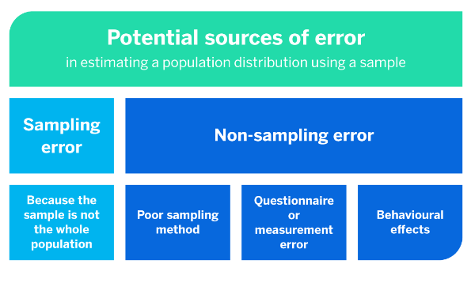





Non Sampling Errors: Present in both sample survey and census survey

Slide 47
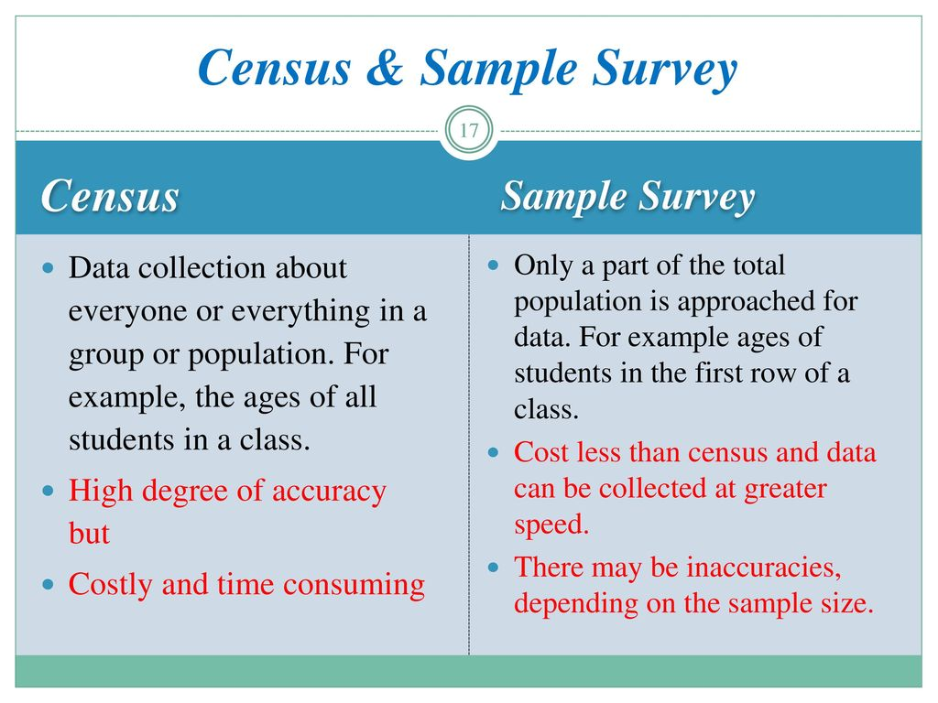



Slide 48
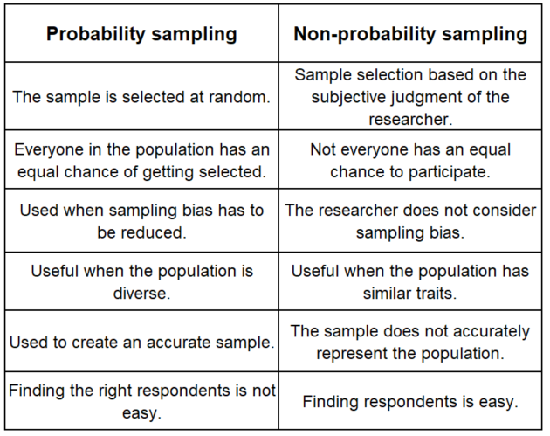





Types of Sampling Designs

Slide 49
Probability Sampling
Simple Random Sampling
Complex Random Sampling Designs
Systematic Sampling
Stratified Sampling
Cluster Sampling
Multi- stage Sampling
Sampling with Probability Proportional to size
Sequential Sampling

